Slide 1
Fuzzy Logic
Course : COMP6065001 Artificial Intelligence
Effective Period : September 2023
Session : 13

Slide 2
Learning Outcomes
At the end of this session, students will be able to:
LO 3: Apply various techniques to an agent when acting under certainty

Slide 3
Outline
Fuzzy Expert System
Fuzzy Inference System

Slide 4
Fuzzy Expert System
There are four basic operations
Fuzzification : Membership function assignment
Inference : Fuzzy rule definition
Composition : Combination of the rule outputs
Defuzzification : Crisp output calculation

Slide 5
Fuzzy Inference System
There are three popular fuzzy inference system
Sugeno
Tsukamoto
Mamdani

Slide 6
Sugeno
Let’s say we want to determine the health of a person based on the height and the weight
Input: Height and Weight
Output : Health level (and its degree)
Very healthy (0.8)
Healthy (0.6)
Somewhat healthy (0.4)
Not healthy (0.2)

Slide 7
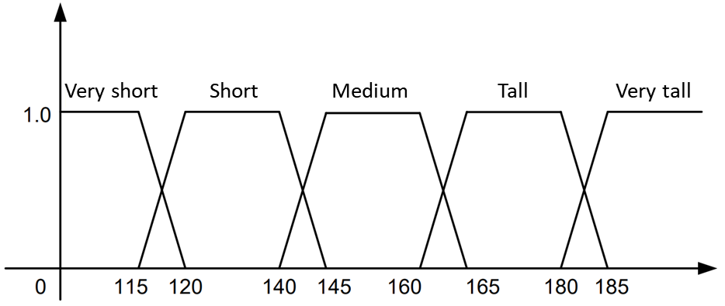
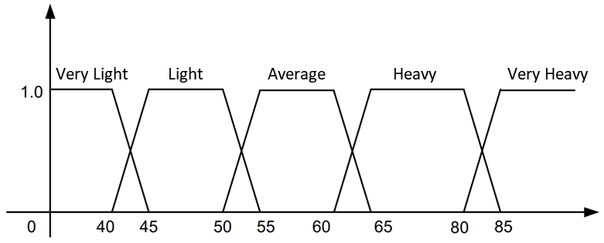
Sugeno
Let us determine the membership function for height and weight

Slide 8
Sugeno
Then we would set the rules
 | Weight
Height |  | V. Light | Light | Average | Heavy | V. Heavy
 | V. Short | VH | H | SH | NH | NH
 | Short | H | VH | H | SH | NH
 | Medium | SH | VH | VH | SH | NH
 | Tall | NH | H | VH | H | NH
 | V. Tall | NH | SH | VH | H | SH

Slide 9
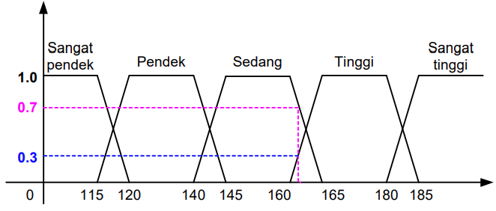


Sugeno
Determine the membership value
$$μ_{medium}\left[161.5\right]=\frac{(165−161.5)}{(165−160)}=0.7$$
$$μ_{tall}\left[161.5\right]=\frac{(161.5−160)}{(165−160)}=0.3$$

Slide 10
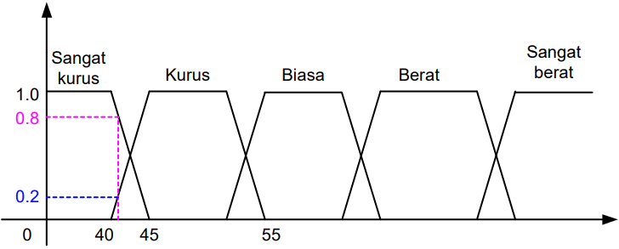


Sugeno
Determine the membership value
$$μ_{v. light}\left[41\right]=\frac{(45−41)}{(45−40)}=0.8$$
$$μ_{light}\left[41\right]=\frac{(41−40)}{(45−40)}=0.2$$

Slide 11
Sugeno
Refer to the rules first. Pick the lowest score (because the relation is AND)
 | Weight
Height |  | 0.8 | 0.2 | Average | Heavy | V. Heavy
 | V. Short | VH | H | SH | NH | NH
 | Short | H | VH | H | SH | NH
 | 0.7 | .7 | .2 | VH | SH | NH
 | 0.3 | .3 | .2 | VH | H | NH
 | V. Tall | NH | SH | VH | H | SH

Slide 12
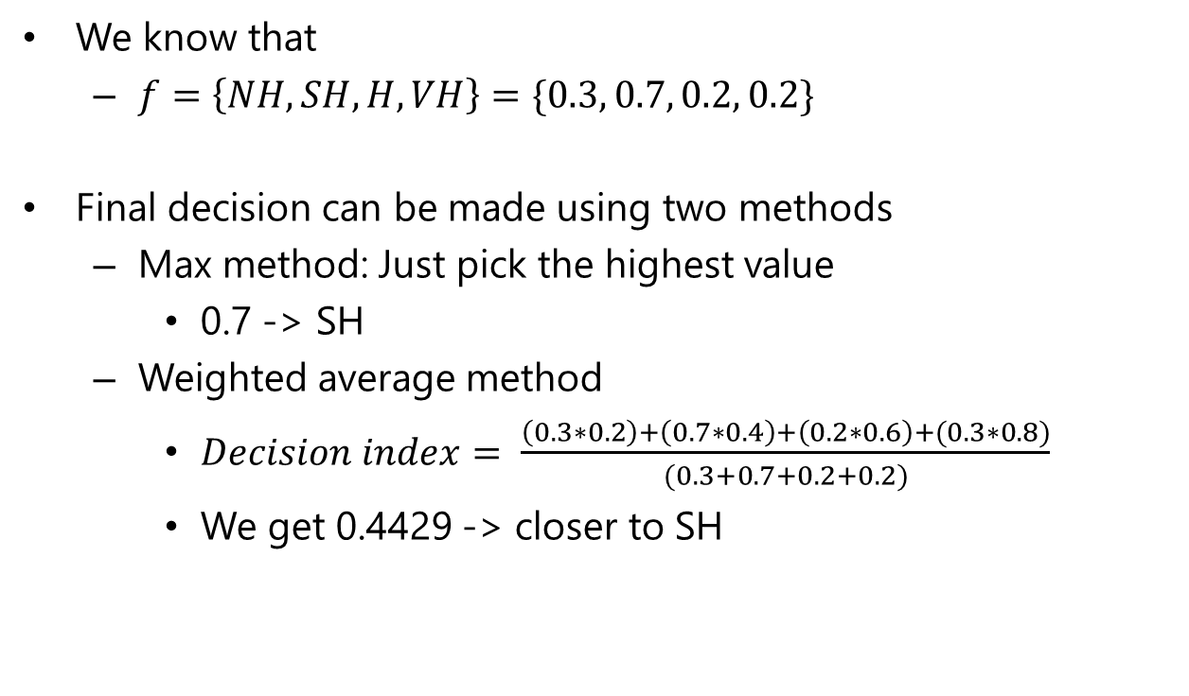
Sugeno
We know that
$f=\left\{NH, SH, H, VH\right\}=\{0.3, 0.7, 0.2, 0.2\}$
Final decision can be made using two methods
Max method: Just pick the highest value
0.7 -> SH
Weighted average method
$Decision index= \frac{\left(0.3∗0.2\right)+\left(0.7∗0.4\right)+\left(0.2∗0.6\right)+(0.3∗0.8)}{(0.3+0.7+0.2+0.2)}$
We get 0.4429 -> closer to SH

Slide 13
Tsukamoto
Case:
A factory has the following records:
Max recorded demand 5k items a day and min 1k items a day
Stock items has a record max of 600 items and min 100 items
Max producing capability is 7k items a day and min 2k items a day
Fuzzy rule:
If demand is high and stock is high, then increase production
If demand is low and stock is low, then decrease production
If demand is low and stock is high, then decrease production
If demand is high and stock is low, then increase production
Question:
How many items should be produced given the demand is 4k and there are 300 items in stock?

Slide 14
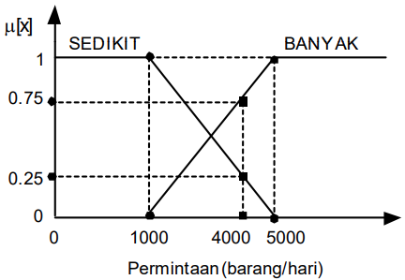


Tsukamoto
Make the membership function for both demand and stock
Low
High
Demand (items/day)
$$μ_{low}\left[4000\right]=\frac{(5000−4000)}{(5000−1000)}=0.25$$
$$μ_{high}\left[4000\right]=\frac{(4000−1000)}{(5000−1000)}=0.75$$

Slide 15
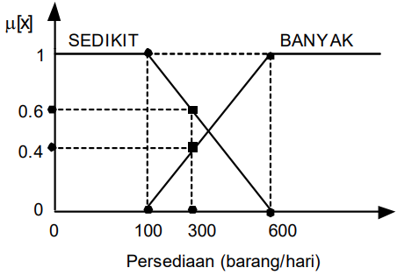


Tsukamoto
Make the membership function for both demand and stock
Low
High
Stock (items/day)
$$μ_{low}\left[300\right]=\frac{(600−300)}{(600−100)}=0.6$$
$$μ_{high}\left[300\right]=\frac{(300−100)}{(600−100)}=0.4$$

Slide 16
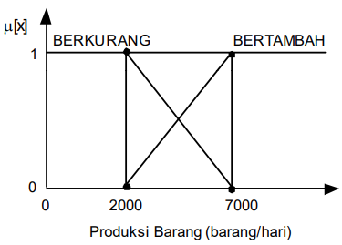
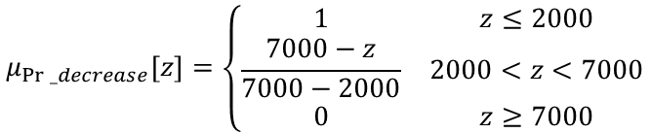
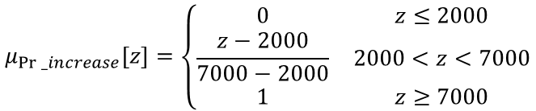
Tsukamoto
Make the membership function for production
Decrease
Increase
Production (items/day)
$$μ_{Pr⁡_decrease}\left[z\right]=\left\{\begin{matrix}1 & z≤2000 \\ \frac{7000−z}{7000−2000} & 2000<z<7000 \\ 0 & z≥7000\end{matrix}\right.$$
$$μ_{Pr⁡_increase}\left[z\right]=\left\{\begin{matrix}0 & z≤2000 \\ \frac{z−2000}{7000−2000} & 2000<z<7000 \\ 1 & z≥7000\end{matrix}\right.$$

Slide 17
Tsukamoto
Now let’s make the truth table that show the relation between stock, demand, and production
Then we can set the membership degree values
Since the logic is set to “IF x AND y THEN z”, pick the minimum
 | Demand
Stock |  | High | Low
 | High | ++ | --
 | Low | ++ | --
 | Demand
Stock |  | High: 0.75 | Low: 0.25
 | High: 0.4 | .4 | .25
 | Low : 0.6 | .6 | .25

Slide 18
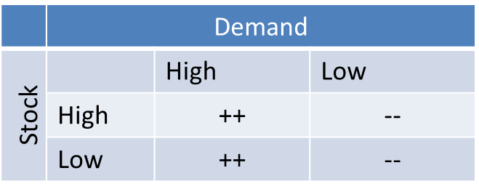
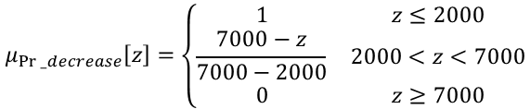

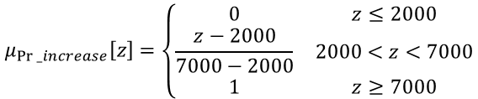
Tsukamoto
Now let’s make the truth table that show the relation between stock, demand, and production
We know that:
Now we want to find the $z$ that fulfills the $μ$ in the production
$$μ_{Pr⁡_decrease}\left[z\right]=\left\{\begin{matrix}1 & z≤2000 \\ \frac{7000−z}{7000−2000} & 2000<z<7000 \\ 0 & z≥7000\end{matrix}\right.$$
$$μ_{Pr⁡_increase}\left[z\right]=\left\{\begin{matrix}0 & z≤2000 \\ \frac{z−2000}{7000−2000} & 2000<z<7000 \\ 1 & z≥7000\end{matrix}\right.$$
 | Demand
Stock |  | High: 0.75 | Low: 0.25
 | High: 0.4 | 4000 | 5750
 | Low : 0.6 | 5000 | 5750

Slide 19

Tsukamoto
Finally, we can find the final number of the items that should be produced by:
$$Z=\frac{.4∗4000 + .6∗5000 + .25∗5750 + .25∗5750}{.4+.25+.25+.6}≈4983$$

Slide 20
Mamdani
Let’s say we have a simple following case with two inputs, one output, and three rules (with its simplified translation)
Rules:
If fund is adequate OR n_staff is small, then risk is low
If x is A3 OR y is B1, then z is C1
If fund is marginal AND n_staff is large, then risk is normal
If x is A2 AND y is B2, then z is C2
If fund is inadequate, then risk is high
If x is A1, then z is C3

Slide 21
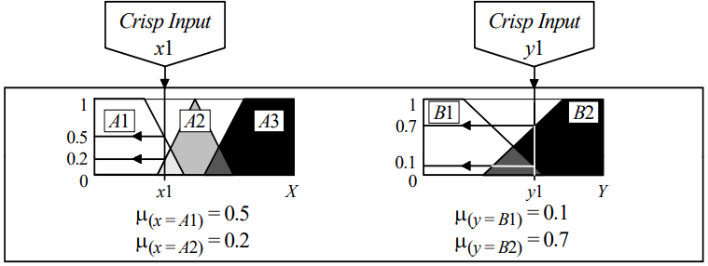

Mamdani
To make it simple, let’s assume that we already know the membership function, we want to check a custom input (x1 and y1) membership degree
$μ_{(x=A1)}=0.5$
$μ_{(x=A2)}=0.2$
$μ_{(y=B1)}=0.1$
$μ_{(y=B2)}=0.7$

Slide 22
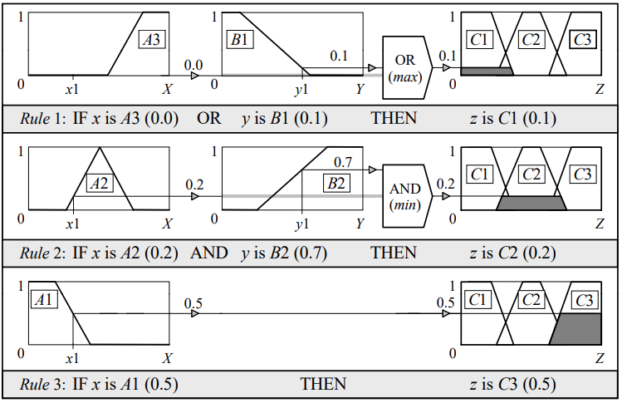
Mamdani
Now, we want match the (assumed) information with the rules

Slide 23
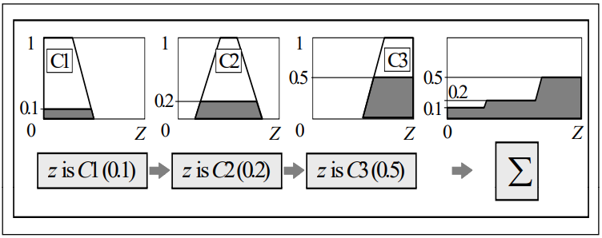
Mamdani
Now, we can aggregate the obtained rule outputs into a single fuzzy set

Slide 24
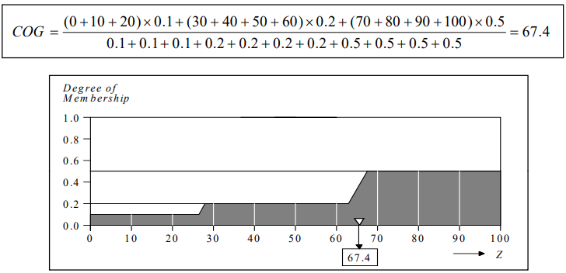
Mamdani
Lastly, to determine the value of z we can use center of gravity method (among many others ofc)

Slide 25
References
Lee, K.H., First Course on Fuzzy Theory and Applications, Springer, 2005

